Slide 1


MATE-GEAC
Leisure Sports Department
How to join?

Slide 2


What do you need to join?
Active student status
Fill out the right form:
    Gödöllő: https://forms.office.com/r/m9gSNsiwwN
    Kaposvár: https://forms.office.com/e/7urJfGBU0f
Registration with the same e-mail address which you gave at the form in www.foggosport.com
  Activate your profil with the verifying e-mail (please check the spam)
Gödöllő: We will send an e-mail to you in couple days when you can get your membership card.

Slide 3
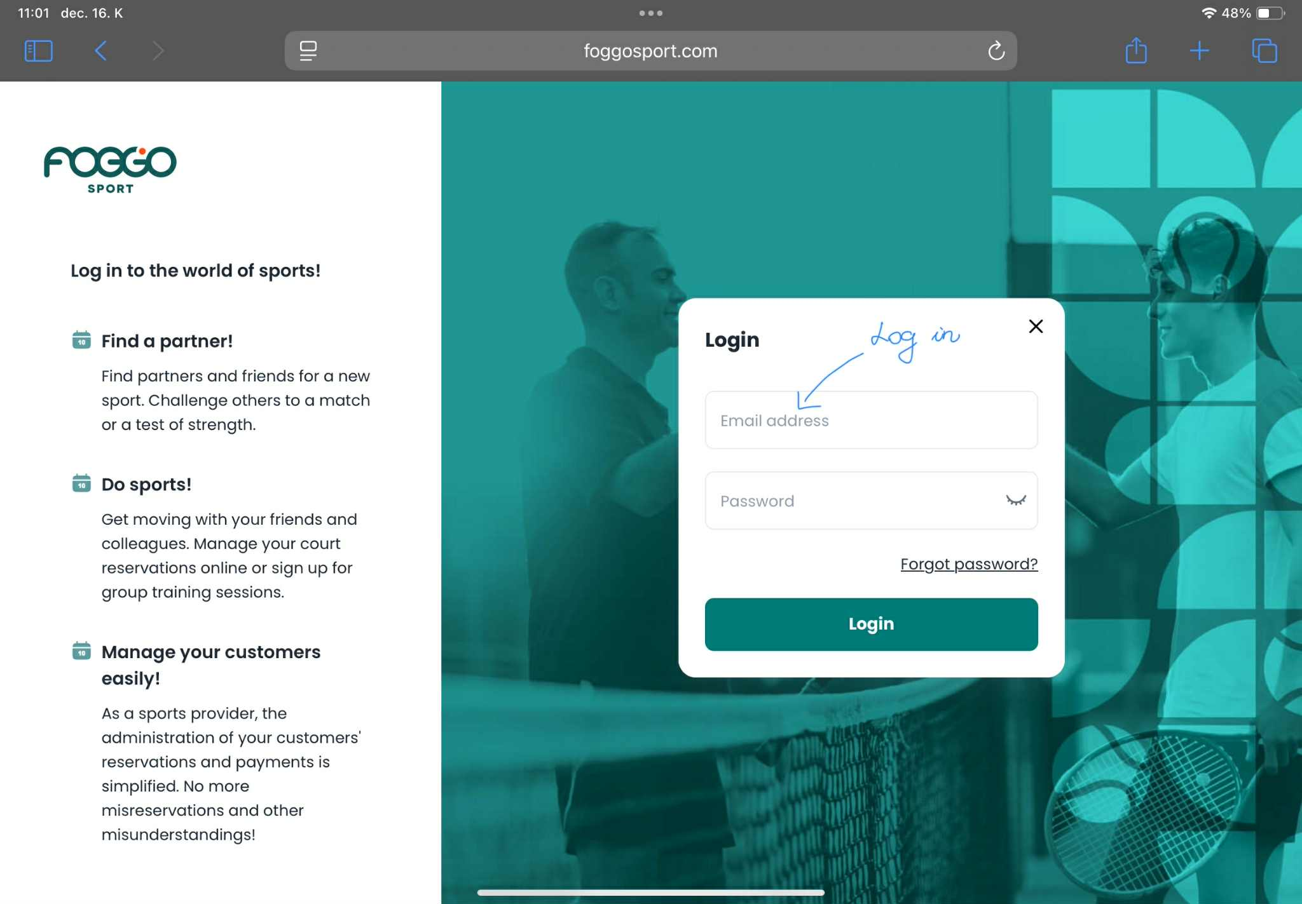
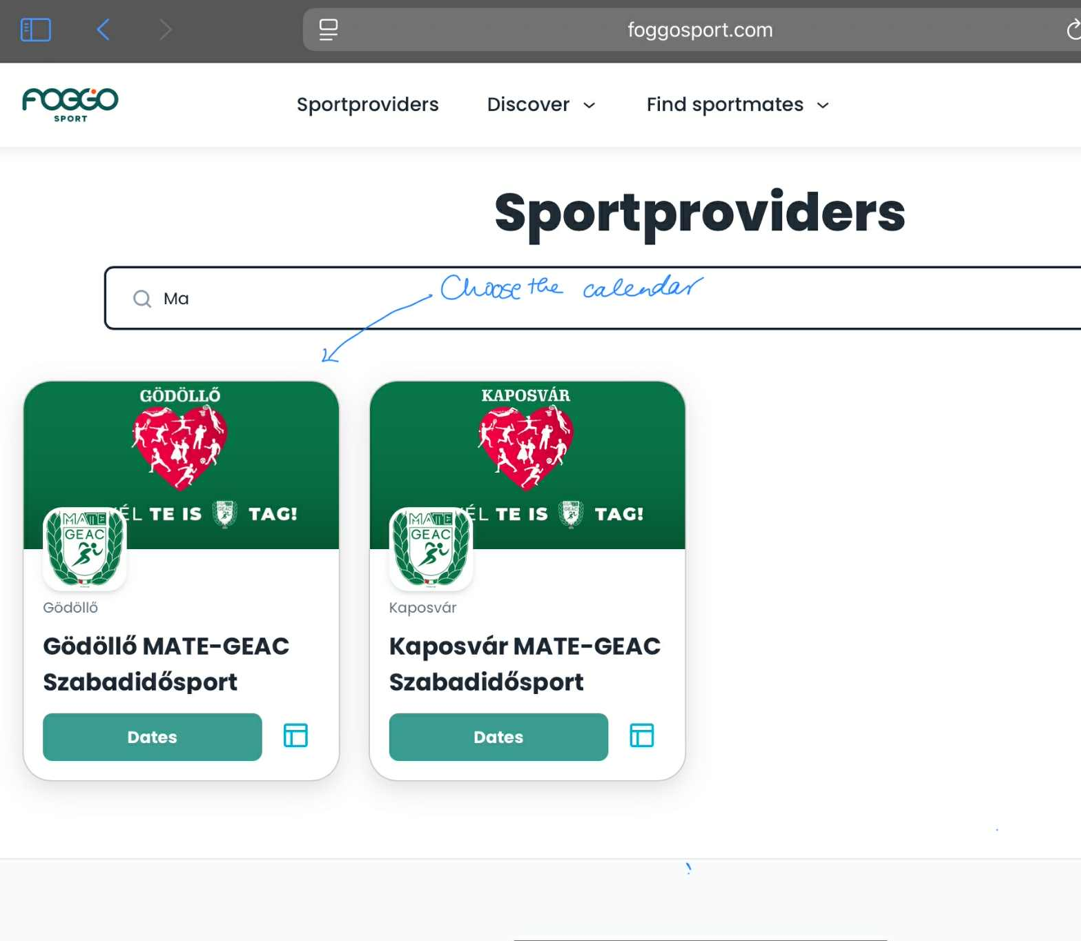
How to book?
1. Log in to www.foggosport.com using your email address and password.
2. Search for and select the MATE-GEAC Leisure Sports provider.

Slide 4
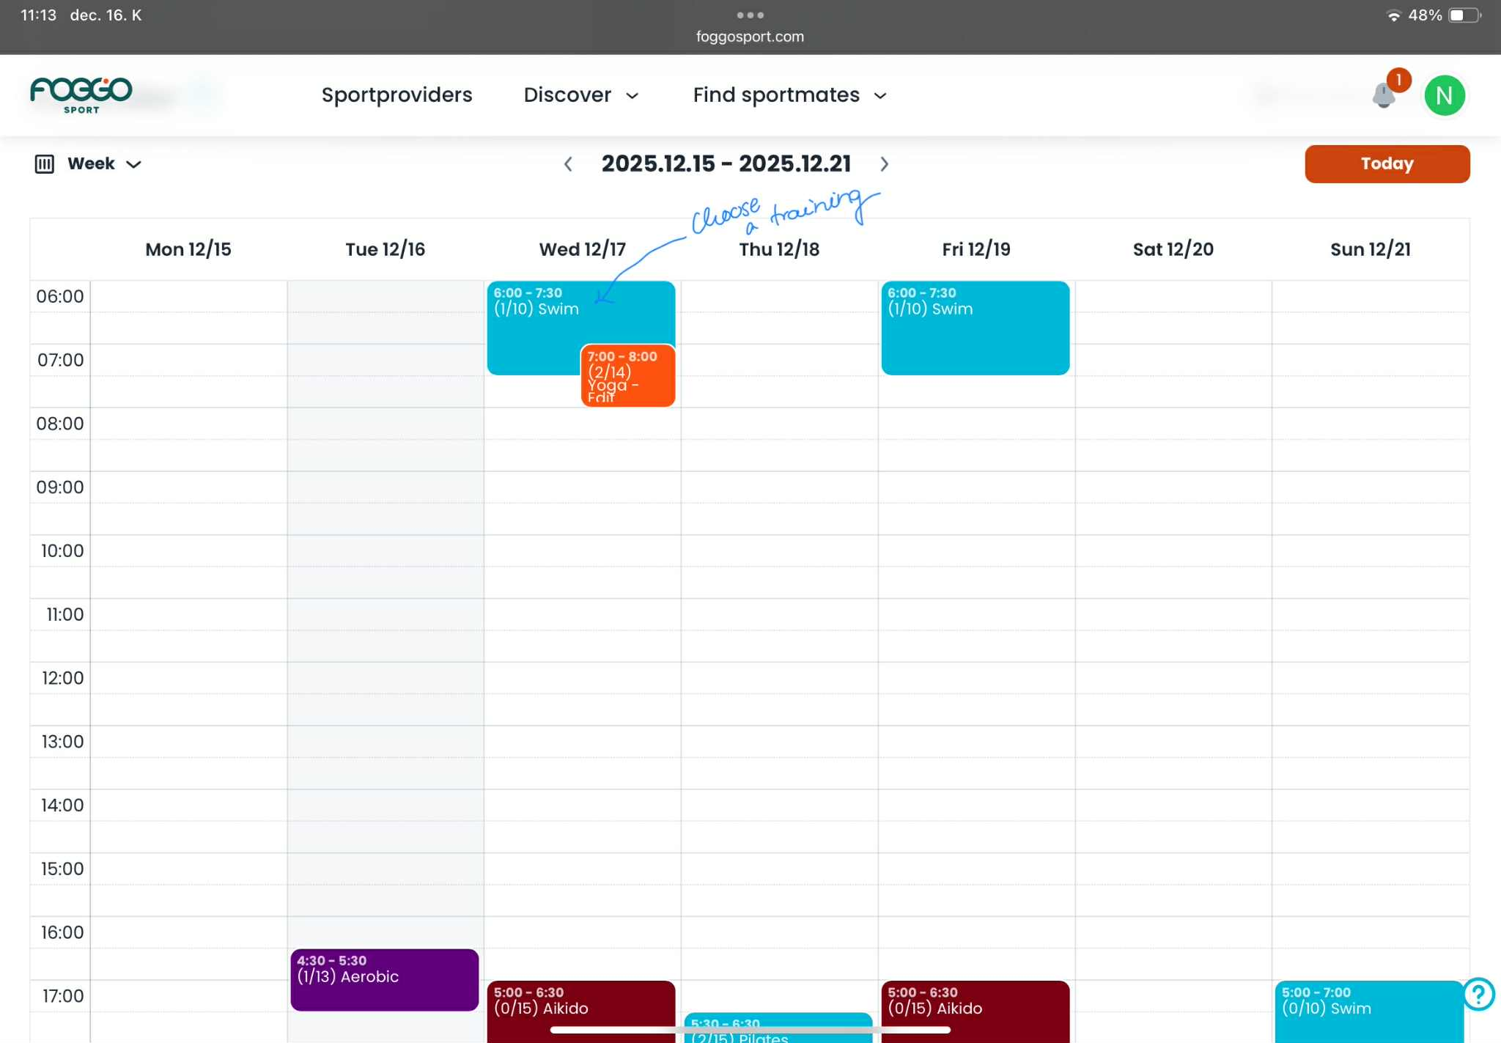
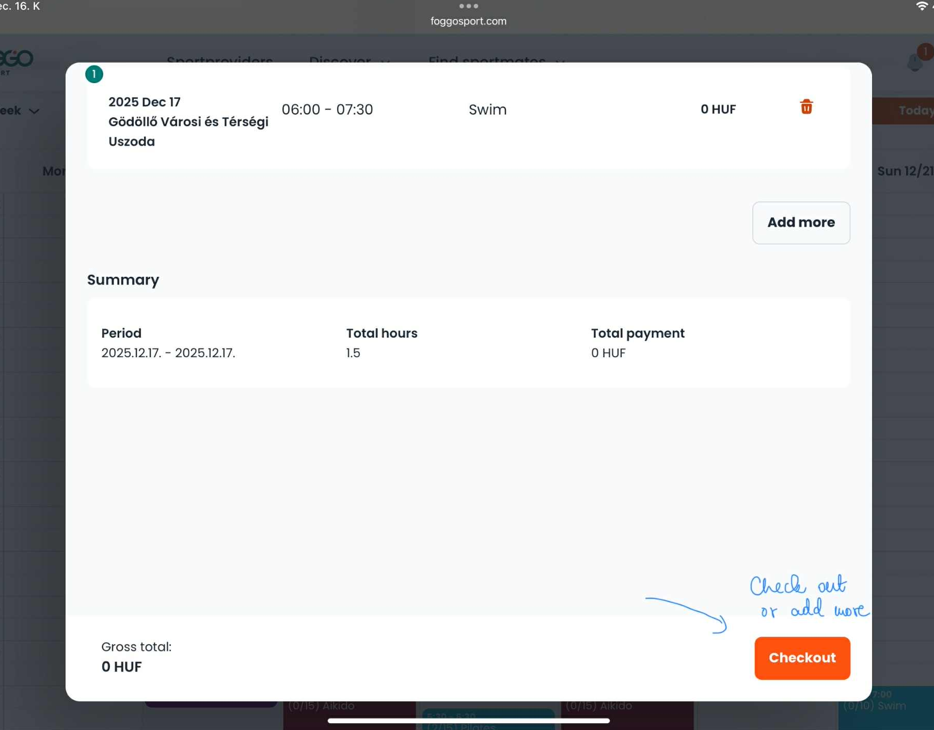
How to book?
3. Choose a training
4. Review your selected training session and click „Checkout” to continue.

Slide 5
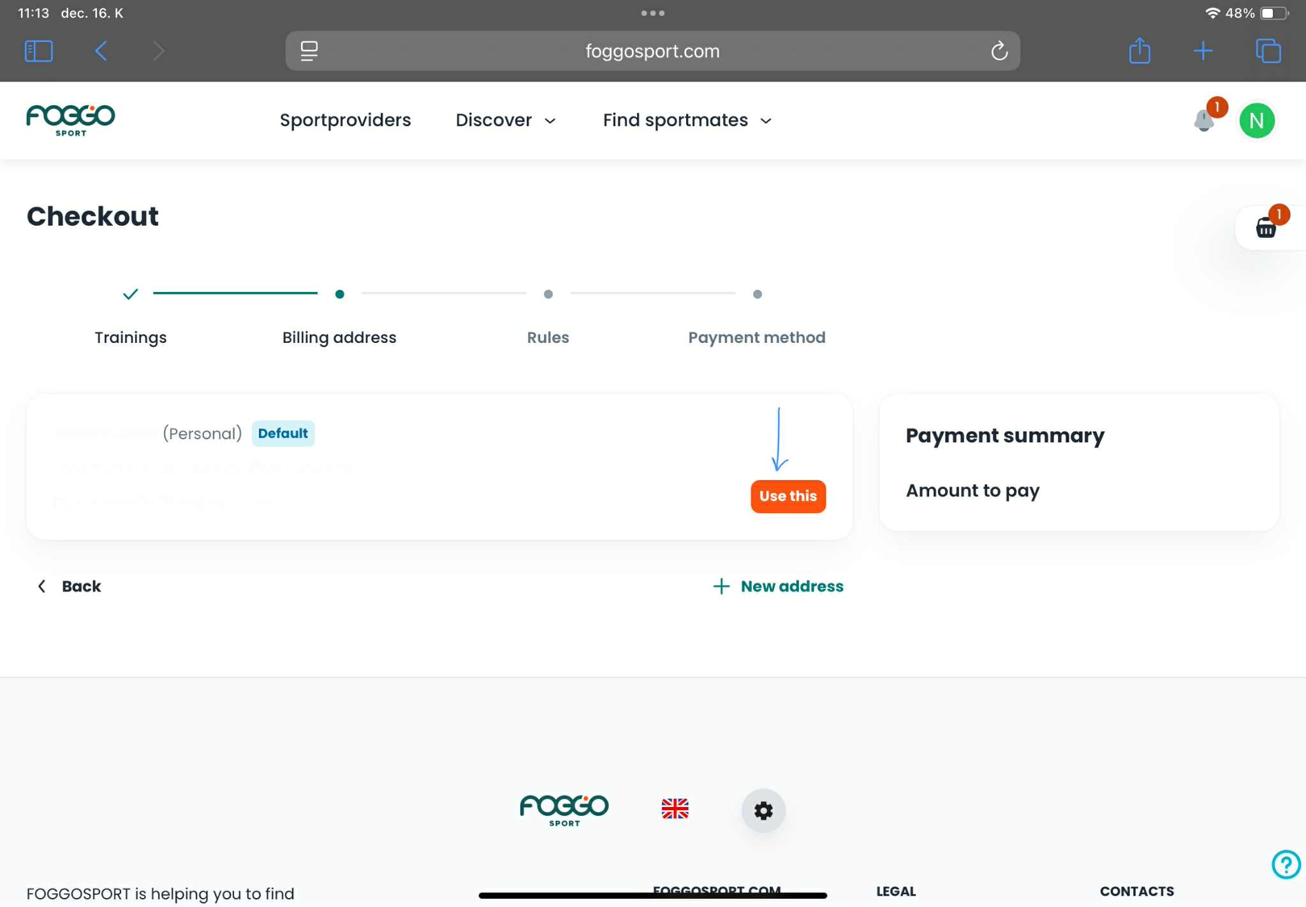
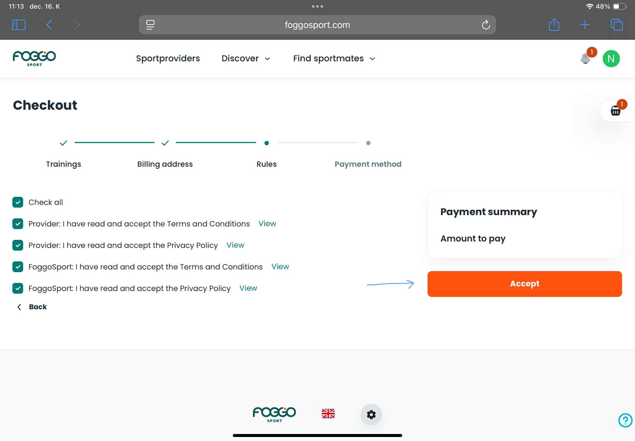
How to book?
5. Select your billing address or add a new one if needed.
6. Accept the Terms and Conditions and the Privacy Policy, then click „Accept”.

Slide 6
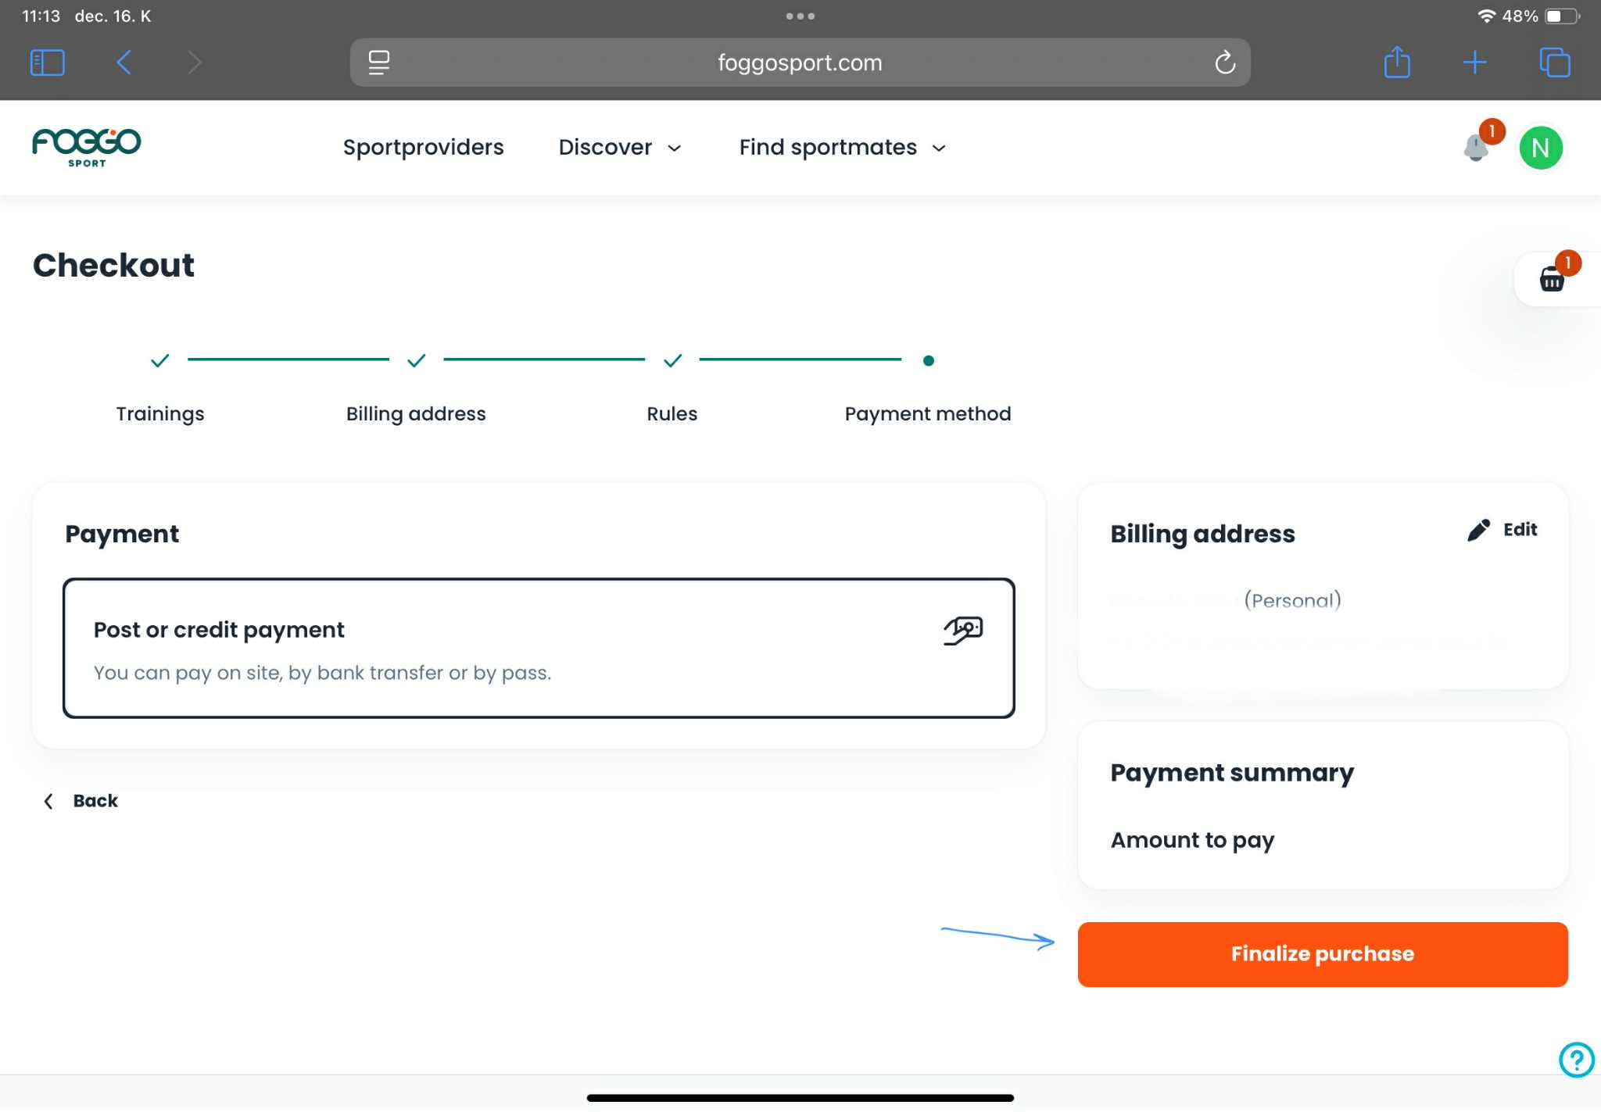
How to book?
7. Select „Post or credit payment” as your payment method.
8. Click „Finalize purchase” to complete your booking.

Slide 7
Leisure Sports Department
Membership Fees
Membrship fees
Dormitory Students: there is no extra membership fee, because of the student service development contribution fee in the dormitory.
Student: the membership fee is 1500 HUF/month, which is charged in the Neptun system 7500 HUF/semester. This amount must be paid as soon as possible, but no later than the start of the exam period.

Slide 8
Membership discounts
Gödöllő
20% discount on the monthly pass price at the gym of “B” dormitory.
The facilities of the Institute of Physical Education and Sports can be rented with a 25% discount, subject to availability. (Prior arrangement with the Institute of Physical Education and Sports is required in all cases.)
Beyond the free time slots provided for our members in the swimming pool, a 50% discount on swimming tickets is available upon presenting the membership card.

Slide 9


